Slide 1


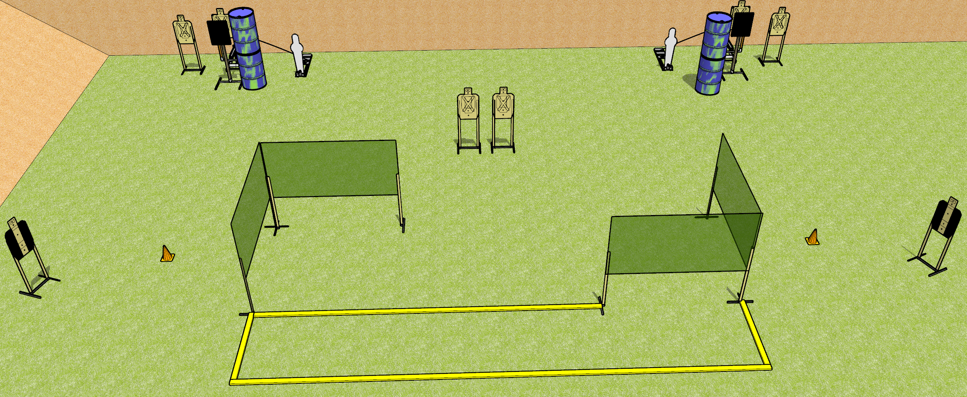
 | Dothan Gun Club – USPSA Match Bobbing Along Course Designer : Drew Coleman
START POSITION : Standing with heels touching left or rightmost fault line, outside the shooting area, wrists below belt
GUN READY CONDITION : Pistol loaded and holstered. PCC loaded, held with both hands, shouldered, safety on, pointed at either orange cone. |  | SCORING: Comstock, 18 rounds TARGETS: 8 paper, 2 Steel SCORED HITS: Best 2 on paper, steel until down START-STOP: Audible, last shot RULES: The bobbers must be activated before being shot, and are not disappearing targets.
STAGE PROCEDURE: Engage targets as they become available from within the fault lines.

Slide 2
Bobbing Along
Written Stage Briefing
Bobbing Along is an 18 round, 90 point, Comstock medium course. There are eight USPSA targets and two pepper poppers. The best two hits on paper will score, and steel must fall to score.
The bobbing targets are not disappearing targets and must be activated before being engaged. Please check the activators before walkthrough and set them up the same way every time.
Handgun start position is standing with heels touching left or rightmost fault line, outside the shooting area, wrists below belt. Handgun is loaded and holstered.
PCC start position is standing with heels touching left or rightmost fault line, outside the shooting area, muzzle pointed at either orange cone. Loaded carbine is held with both hands, shouldered, safety on.
On start signal, engage targets as they become available from within the shooting area.

